Slide 1
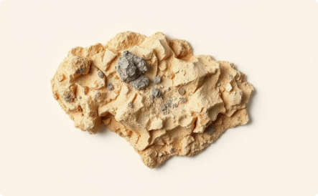
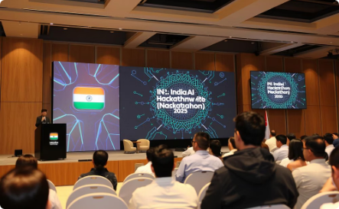
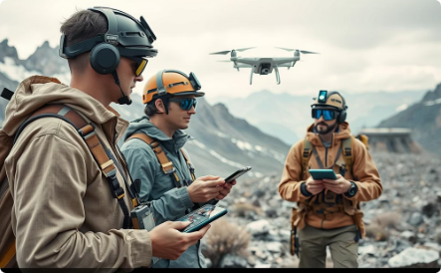
Raw Materials 360: AI-Driven Mineral Targeting
Cutting-edge AI technology for mineral exploration
Harnessing advanced algorithms to identify potential mineral sites.
Improves efficiency and accuracy in resource detection.
Welcome to IndiaAI Hackathon 2025
Bringing innovators and technologists together for breakthroughs.
Fostering collaboration in AI-powered geological solutions.
Revolutionizing mineral prospecting through AI
Combining geospatial data with machine learning models.
Enabling data-driven decisions for sustainable mining.

Slide 2
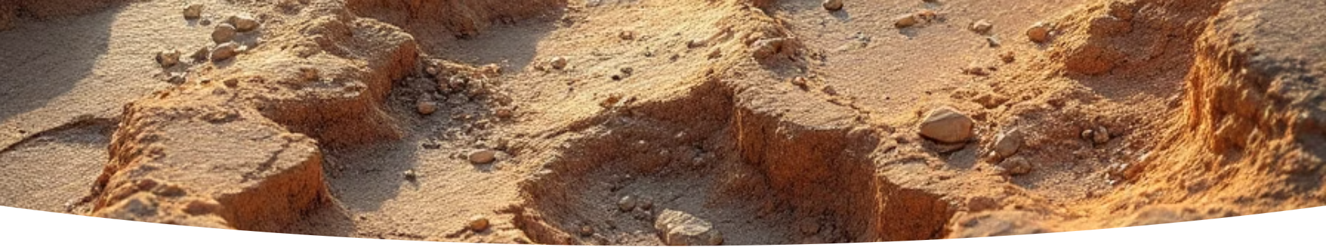



Project ObjectiveRaw Materials 360 aims to revolutionize mineral prospecting in India using AI.
We integrate geospatial data, deep learning, and 3D visualization to identify potential mineral deposits.
Enhance Exploration Efficiency
Improve Prediction Accuracy
Support Sustainable Mining
Reduce time and cost of traditional mineral exploration by 60%.
Achieve 85% accuracy in identifying viable mineral deposits.
Minimize environmental impact through precise targeting.

Slide 3
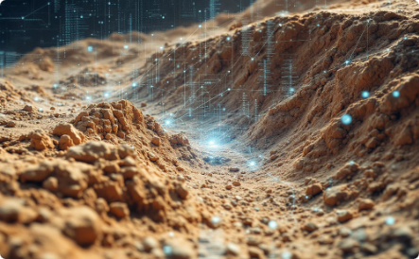
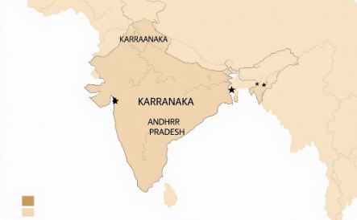
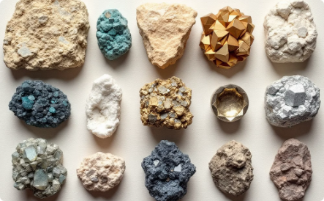
Project Objective
AI for Hidden Deposits
Using artificial intelligence to detect mineral deposits hidden deep underground.
Advanced algorithms analyze complex geological data to predict new resource locations.
Enhancing exploration accuracy and increasing discovery success rates significantly.
Focus Regions
Exploration focused on Karnataka and Andhra Pradesh, key mineral-rich states in India.
Targeting areas with promising geology and existing mining infrastructure to optimize results.
Collaborating with local authorities and experts for effective and sustainable exploration.
Target Minerals
Key minerals including Rare Earth Elements (REE), Nickel-Platinum Group Elements (Ni-PGE),
and Copper.
Also focusing on valuable resources like Gold, Diamond, Iron, and Manganese to diversify
prospects.
Ensuring broad coverage to support multiple industrial and technological sectors.

Slide 4
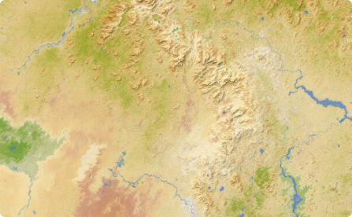
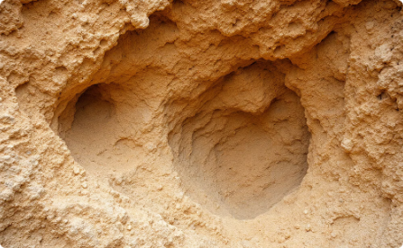
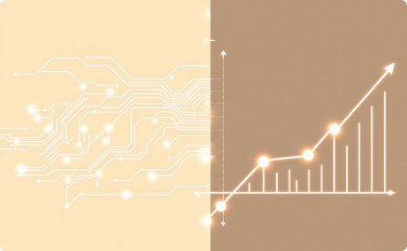
Problem Statement
Predict New Target Zones
The project aims to identify promising new mineral target areas.
This covers a vast region spanning 39,000 square kilometers.
Advanced AI techniques help prioritize zones for exploration.
Focus on Hidden Deposits
Special focus on mineral deposits that are not easily detectable.
These include concealed and deep-seated mineralizations which pose exploration challenges.
AI-driven models enhance the discovery of such hidden resources.
AI/ML Solutions
Data cleaning ensures the quality and usability of raw geological data.
Integration of diverse data sources is crucial to building robust models.
Depth modeling provides insights into subsurface mineral deposit distributions.

Slide 5
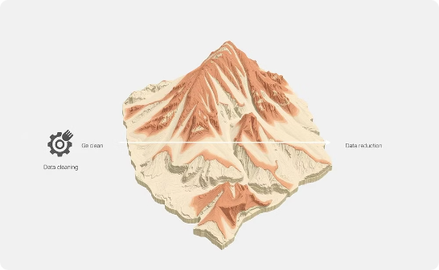
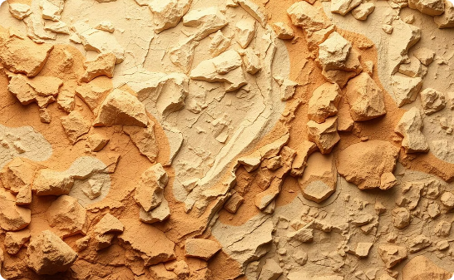
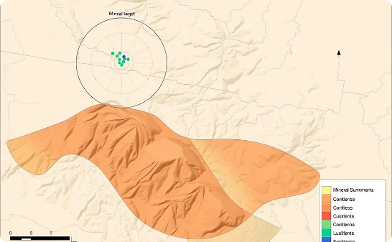
Backend AI Code – A Python-based backend pipeline
Preprocessing geological data for quality and consistency
Applying machine learning to predict mineral prospectivity
Outputting target zones with associated confidence scores

Slide 6
import geopandas as gpd
import rasterio
import numpy as np
import pandas as pd
from sklearn.ensemble import RandomForestClassifier
from sklearn.model_selection import train_test_split
from sklearn.metrics import classification_report
import joblib
# Step 1: Load vector data (e.g., geological structures, lithology)
vector_data = gpd.read_file("path_to_vector/lithology.shp")
# Step 2: Load raster data (e.g., magnetic anomalies, remote sensing bands)
with rasterio.open("path_to_raster/magnetic_anomaly.tif") as src:
mag_data = src.read(1)
transform = src.transform
# Step 3: Merge vector features with raster values
vector_data['mag_anomaly'] = [
mag_data[int(geom.centroid.y), int(geom.centroid.x)]
for geom in vector_data.geometry
]

Slide 7
# Step 4: Feature Engineering (example)
features = vector_data[['litho_type_code', 'mag_anomaly']] # Add more features as needed
labels = vector_data['has_mineral'] # 0 or 1 if labeled, or use unsupervised methods
# Step 5: Train ML model
X_train, X_test, y_train, y_test = train_test_split(features, labels, test_size=0.2)
model = RandomForestClassifier(n_estimators=100, random_state=42)
model.fit(X_train, y_train)
# Step 6: Evaluate
preds = model.predict(X_test)
print(classification_report(y_test, preds))
# Step 7: Save model for backend inference
joblib.dump(model, "mineral_targeting_model.pkl")

Slide 8
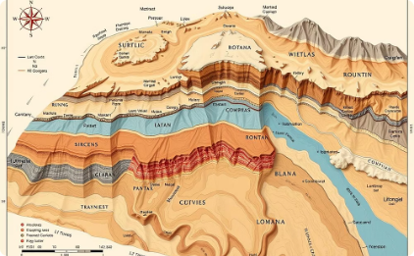
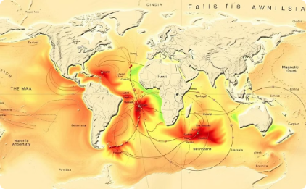
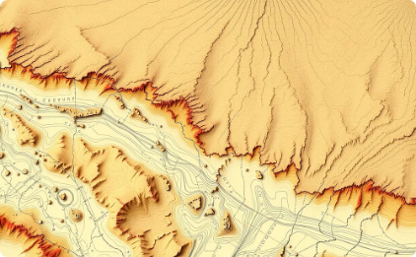
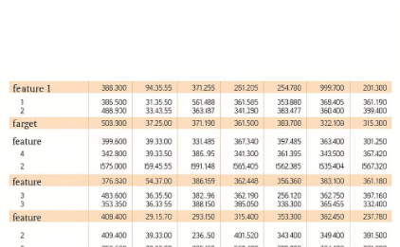
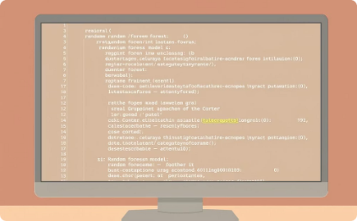
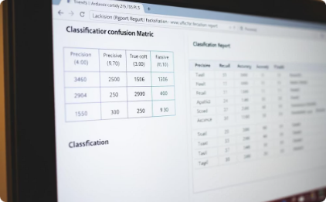
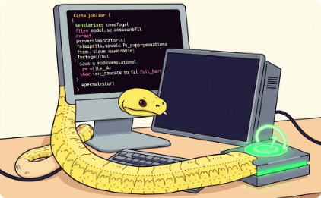
🔧 Backend AI Code (Python)
Step 1: Load vector data
Step 2: Load raster data
Step 3: Merge vector and raster
Step 4: Feature engineering
Import geological vector data such as structures and lithology shapefiles using geopandas.
Read raster data like magnetic anomaly maps or remote sensing bands with rasterio.
Combine vector features with raster pixel values at centroids to enrich dataset.
Prepare features from geological codes and raster values for model input.
Step 5: Train ML model
Step 6: Evaluate model
Step 7: Save model
Use a Random Forest classifier to train on labeled geological features.
Assess prediction accuracy with classification reports on test data.
Export trained model for backend inference and deployment.

Slide 9
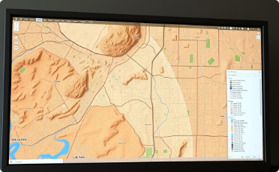
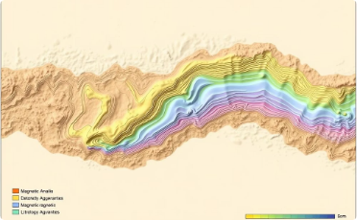
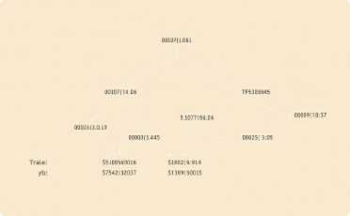
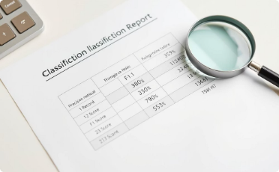
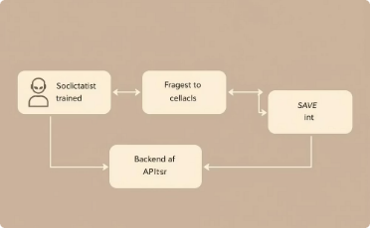
Code Explanation
Data Integration
Load GIS shapefiles and raster data using geopandas and rasterio libraries.
This step ensures all geographic and remote sensing data are correctly formatted and aligned for analysis.
Data from multiple sources is combined to create a comprehensive dataset for exploration modeling. It establishes a solid foundation for subsequent processing stages.
Feature Extraction
Extract key geological features such as magnetic anomalies and lithology codes from the integrated dataset.
These features represent important indicators of mineral presence and help differentiate target zones. Spatial referencing by location enables precise mapping of relevant data points. Feature extraction converts raw data into meaningful inputs for machine learning models.
Model Training
Train a Random Forest classifier using the extracted geological features and known labels.
The model learns patterns associated with mineral zones to predict prospective areas accurately. Training involves fine-tuning hyperparameters to improve prediction performance.
This step is critical for developing a reliable AI-based mineral prospecting tool.
Evaluation
Validate the trained model’s accuracy and robustness using a held-out test dataset. Performance metrics such as precision, recall, and classification reports are analyzed. This ensures the model generalizes well to unseen data and confidently predicts mineral prospects. Evaluation identifies strengths and areas for improvement.
Deployment
Save the trained model in a format suitable for backend server use and inference. Deployment enables the model to be integrated with GIS applications for real-time predictions. This step facilitates practical use of AI insights by geologists and exploration teams. It also allows for model updates as new data becomes available.

Slide 10
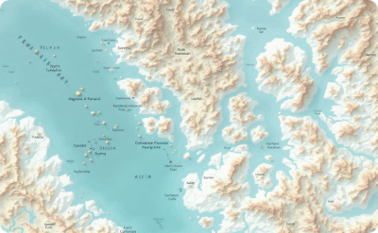
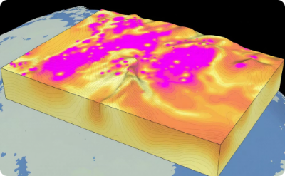

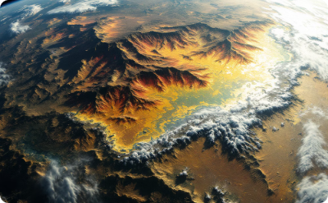
Data Sources for Mineral Exploration
Geological
Geophysical
Geochemical
Remote Sensing
Lithology, faults, folds, contacts
Magnetic, gravity, radiometric data
Surface and subsurface sample assays
Satellite imagery (Sentinel, ASTER)

Slide 11
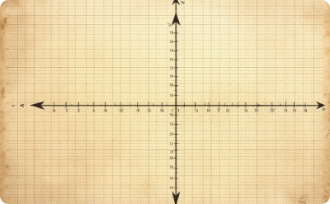
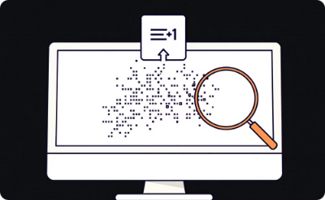
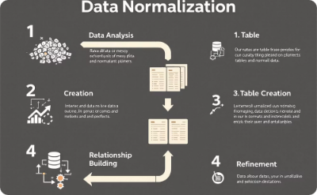
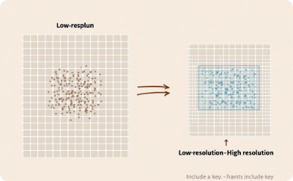
Data Preprocessing
Coordinate Transformation
Missing Values & Noise
Normalization
Resampling
Standardizing feature values for consistency
Aligning datasets to a common resolution
Data converted into a unified projection system
Cleaning and filtering to enhance data quality

Slide 12
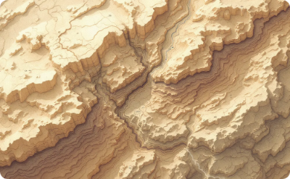
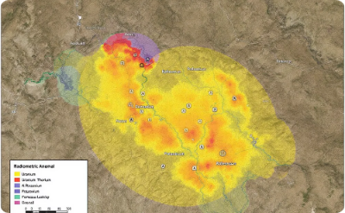

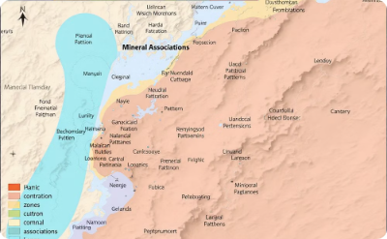
Feature Engineering
Structural Indices
Radiometric Anomalies
Magnetic Gradients
Geochemical Patterns
Measurements of geological complexity
Derivative maps highlighting magnetic variations
Zoning and element associations in geochemistry
Uranium, Thorium, and Potassium signatures

Slide 13

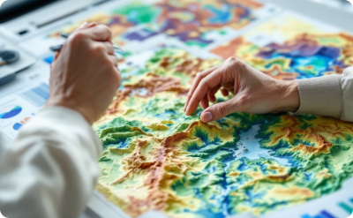
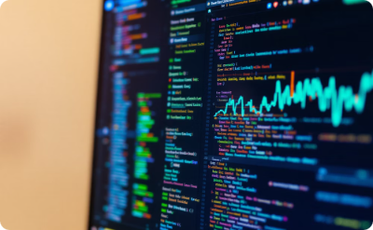

AI/ML Modelling Workflow
Data Curation and Fusion
Feature Extraction
Training AI Models
Prediction and Scoring
Identifying critical indicators
Random Forest, CNNs, and Autoencoders
Integrating diverse data sources
Confidence-based evaluation

Slide 14
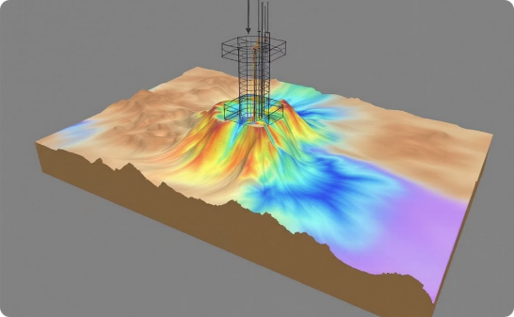
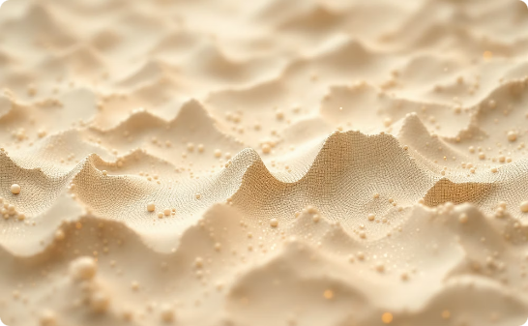
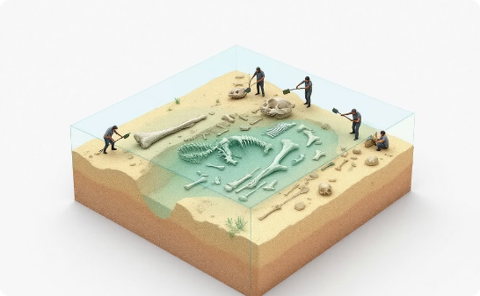
Depth Modelling
3D Geological Models
ML-Based Inversion
Integrated Depth Maps
Constructed from borehole data using geophysical inversion
Detecting deep-seated targets with machine learning algorithms
Visual correlation of surface and subsurface features in 3D

Slide 15
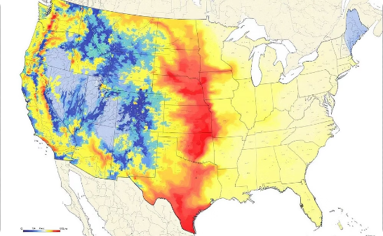
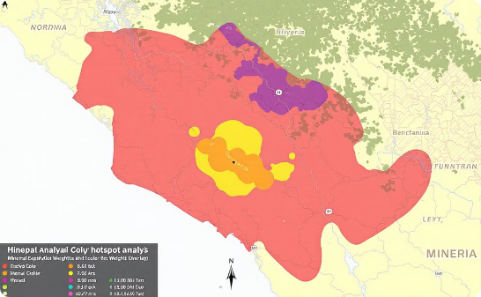
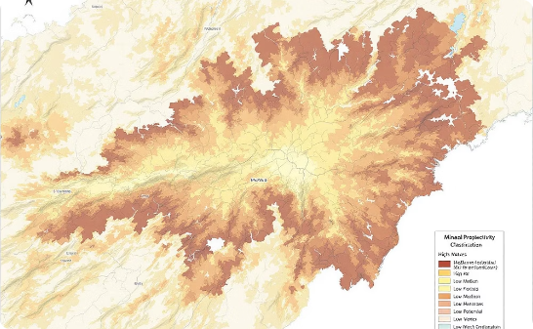
Predictive Mineral Maps
Multi-layer Integration
Hotspot Identification
Prospectivity Classification
Combined data showing potential zones
Weighted overlay analysis
High, medium, low potential areas

Slide 16
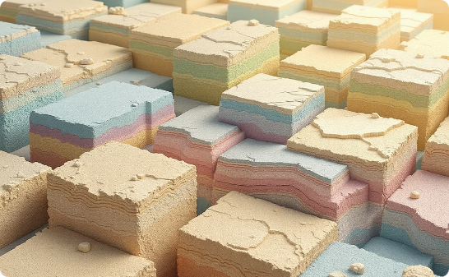
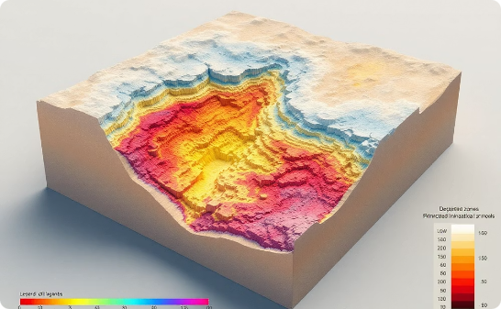
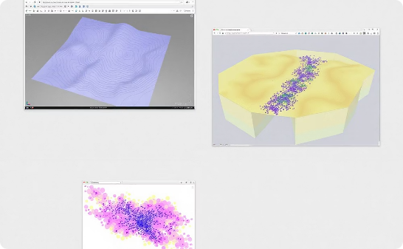
Output: 3D Visualization
3D blocks of subsurface geology and mineral intercepts
Depth slices of predicted mineralization with voxel models
Visualization tools: Leapfrog, ParaView, custom Python plots

Slide 17
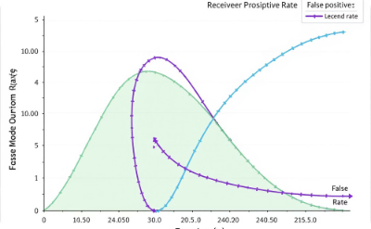
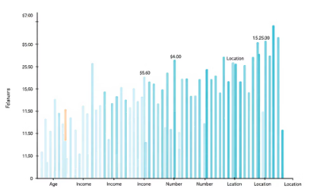
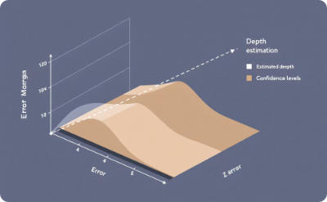
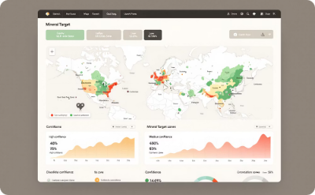
Error Analysis & Confidence Assessment
ROC & Precision-Recall Curves
Feature Contribution (SHAP)
Error Margins in Depth
Confidence Scores
Reliability of predictive targets
Model validation and performance evaluation
Impact of features on predictions
Quantifying uncertainty in subsurface predictions

Slide 18





Ethical AI, IPR & Governance
Ethical AI Code
Open-Source Tools
Institutional NOC
No Copyrighted Content
Developed following strong ethical principles ensuring responsible AI.
Utilizing open-source tools with proper acknowledgment and credits.
Obtained No Objection Certificate from respective institutions or employers.
Ensuring zero use of copyrighted or patented materials.
Policy Compliance
Adhering strictly to MeitY and GSI data governance guidelines.

Slide 19




Impact & Future Roadmap
Accelerates mineral discovery in underexplored regions
Reduces time and cost of traditional surveys
Scalable framework for pan-India deployment
Future work: Real-time satellite-AI fusion, domain adaptation

Slide 20




Team & Acknowledgements
Vaddi Naveenkumar
Institutional Support
Expert Mentorship
GitHub Repository
Lead and project coordinator
Special thanks to Geological Survey of India, IndiaAI Mission, and dataset providers for making this project possible.
Guidance from Senior Principle Data Scientist
“Ravi Katukam” at AIonOS India Pvt Ltd, India.
https://github.com/Naveenkumar-vaddi/Raw-Materials-360-AI-Driven-Mineral-Targeting-Vaddi-Naveenkumar

Slide 21



Thank You
We appreciate your interest in our AI-driven mineral exploration project. Let's connect for collaborations and innovation.
Contact us: Vaddi.Naveen@aionos.ai | +91-9666080844, Hyderabad AIonOS India Pvt Ltd,
Hello@aionos.ai
Visit us at Aionos India Pvt Ltd
601, 602, 6th Floor, Emaar, MGF Capital Tower 1, Sikanderpur, Sector -26, Gurugram, Haryana, 122002
We welcome your questions and valuable feedback to enhance our AI mineral exploration model.

